Slide 1
MODULE 3 SQL DML, Physical Data Organization

Slide 2
SYLLABUS
SQL DML (Data Manipulation Language)
SQL queries on single and multiple tables, Nested queries (correlated and non-correlated), Aggregation and grouping, Views, assertions, Triggers, SQL data types.
Physical Data Organization
Review of terms: physical and logical records, blocking factor, pinned and unpinned organization. Heap files, Indexing, Singe level indices, numerical examples, Multi-level-indices, numerical examples, B-Trees & B+-Trees (structure only, algorithms not required), Extendible Hashing, Indexing on multiple keys – grid files

Slide 3
Data-manipulation language(DML)
DML is short name of Data Manipulation Language which deals with data manipulation and includes most common SQL statements such SELECT, INSERT, UPDATE, DELETE, etc., and it is used to store, modify, retrieve, delete and update data in a database.
SELECT - retrieve data from a database
INSERT - insert data into a table
UPDATE - updates existing data within a table
DELETE - Delete all records from a database table

Slide 4
SQL queries on single and multiple tables
SQL has one basic statement for retrieving information from a database; the SELECT statement
SELECT <attribute list>
FROM <table list>
WHERE <condition>
<attribute list>
is a list of attribute names whose values are to be retrieved by the query
<table list>
is a list of the relation names required to process the query
<condition>
is a conditional (Boolean) expression that identifies the tuples to be retrieved by the query

Slide 5
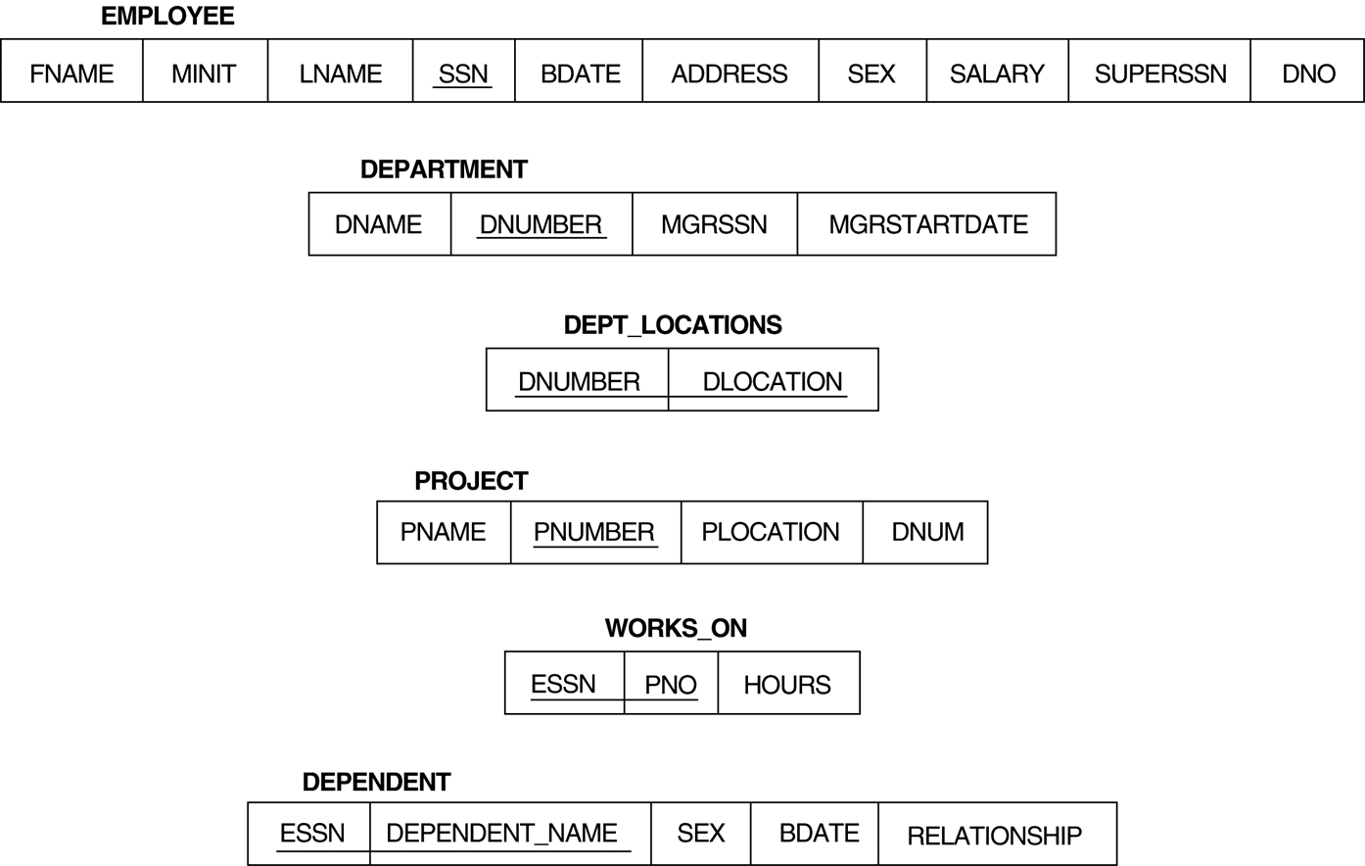

Slide 6
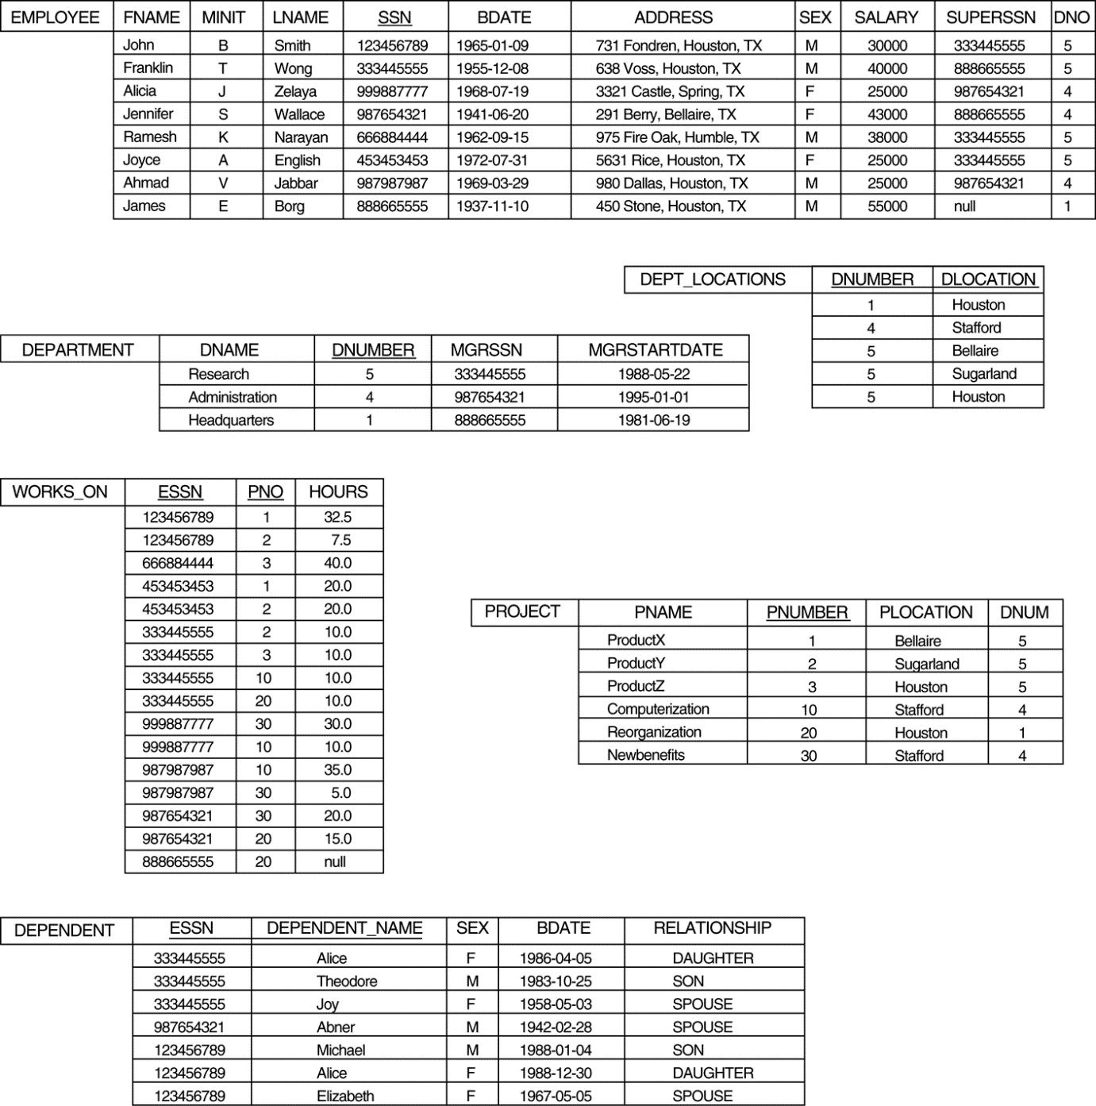

Slide 7


Q0.Retrieve the birth date and address of the employee(s) whose name is ‘John B. Smith’.

Slide 8


Q1. Retrieve the name and address of all employees who work for the ‘Research’ department.
Q2. For every project located in ‘Stafford’, list the project number, the controlling department number, and the department manager’s last name, address, and birth date

Slide 9
Dealing with Ambiguous Attribute Names and Renaming (Aliasing)
In SQL the same name can be used for two (or more) attributes as long as the attributes are in different relations.
If this is the case, and a query refers to two or more attributes with the same name, we must qualify the attribute name with the relation name, to prevent ambiguity.
This is done by prefixing the relation name to the attribute name and separating the two by a period (.)
Eg) Suppose that the DNO and LNAME attributes of the EMPLOYEE relation were called DNUMBER and NAME and the DNAME attribute of DEPARTMENT was also called NAME; then, to prevent ambiguity, query Q1 would be rephrased as

Slide 10



Slide 11

Q3.For each employee, retrieve the employee’s first and last name and the first and last name of his or her immediate supervisor.
Alternative relation names E and S are called aliases or tuple variables, for the EMPLOYEE relation.
An alias follow the keyword AS
It is also possible to rename the relation attributes within the query in SQL by giving them aliases.

Slide 12


Slide 13


Use of the Asterisk (*)
To retrieve all the attribute values of the selected tuples, we do not have to list the attribute names explicitly in SQL;
we just specify an asterisk (*), which stands for all the attributes
Q) Retrieves all the attribute values of any EMPLOYEE who works in DEPARTMENT number 5
Q)Retrieves all the attributes of an EMPLOYEE and the attributes of the DEPARTMENT in which he or she works for every employee of the ‘Research’ department

Slide 14
Tables as Sets in SQL
SQL usually treats a table not as a set but rather as a multiset;
duplicate tuples can appear more than once in a table, and in the result of a query.
SQL does not automatically eliminate duplicate tuples in the results of queries.
DISTINCT Keyword
to eliminate duplicate tuples from the result of an SQL querys we use the keyword DISTINCT in the SELECT clause
only distinct tuples should remain in the result
a query with SELECT DISTINCT eliminates duplicates, whereas a query with SELECT ALL does not.
SELECT with neither ALL nor DISTINCT is equivalent to SELECT ALL

Slide 15
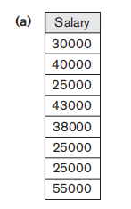


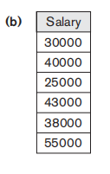
Q) Retrieves the salary of every employee without distinct
Q) Retrieves the salary of every employee using
keyword DISTINCT

Slide 16
UNION, EXCEPT and INTERSECT
set union (UNION), set difference (EXCEPT), and set intersection (INTERSECT) operations.
The relations resulting from these set operations are sets of tuples; that is, duplicate tuples are eliminated from the result.
These set operations apply only to union-compatible relations, so we must make sure that the two relations on which we apply the operation have the same attributes and that the attributes appear in the same order in both relations
UNION ALL
The UNION ALL command combines the result set of two or more SELECT statements (allows duplicate values).

Slide 17
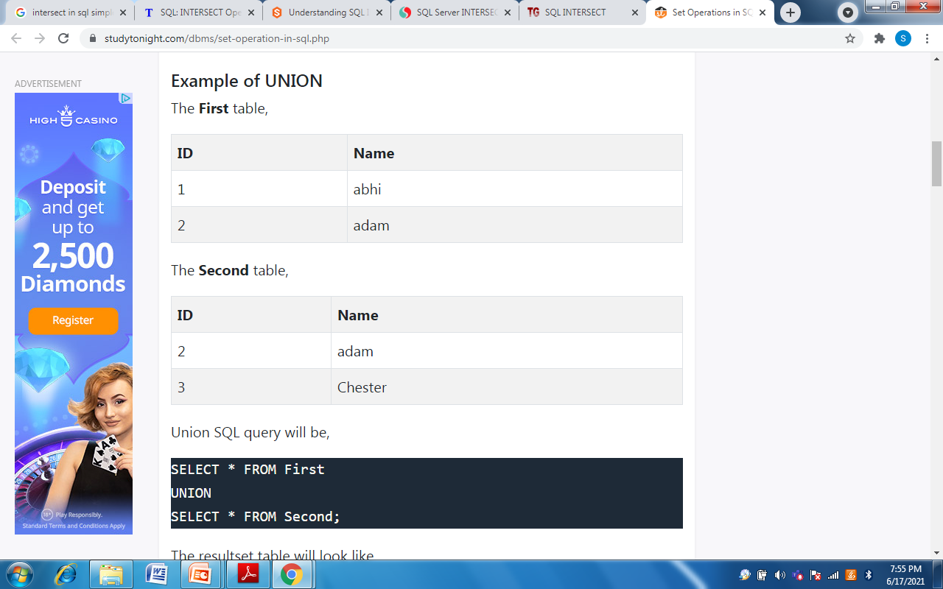
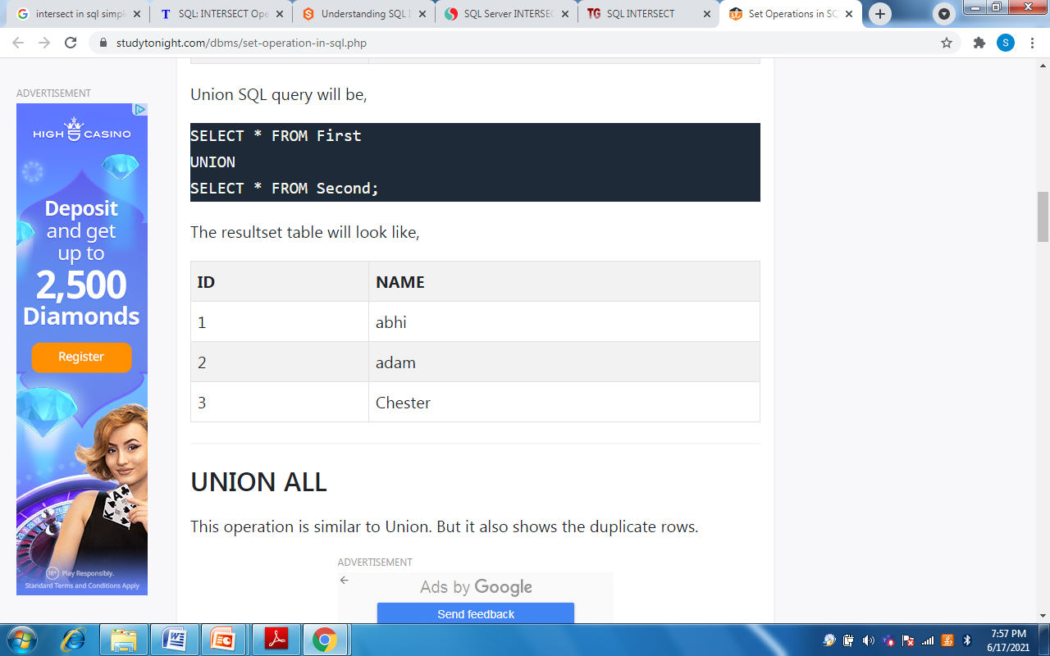
Example 1: UNION

Slide 18
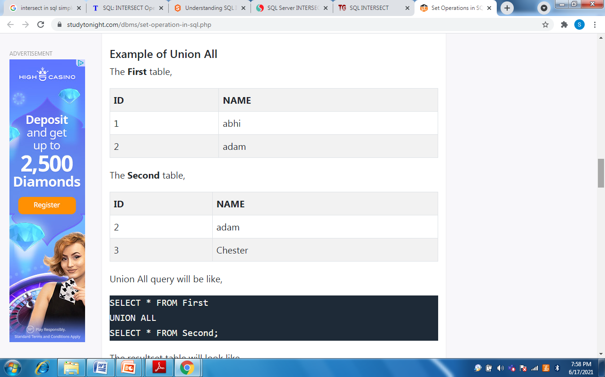
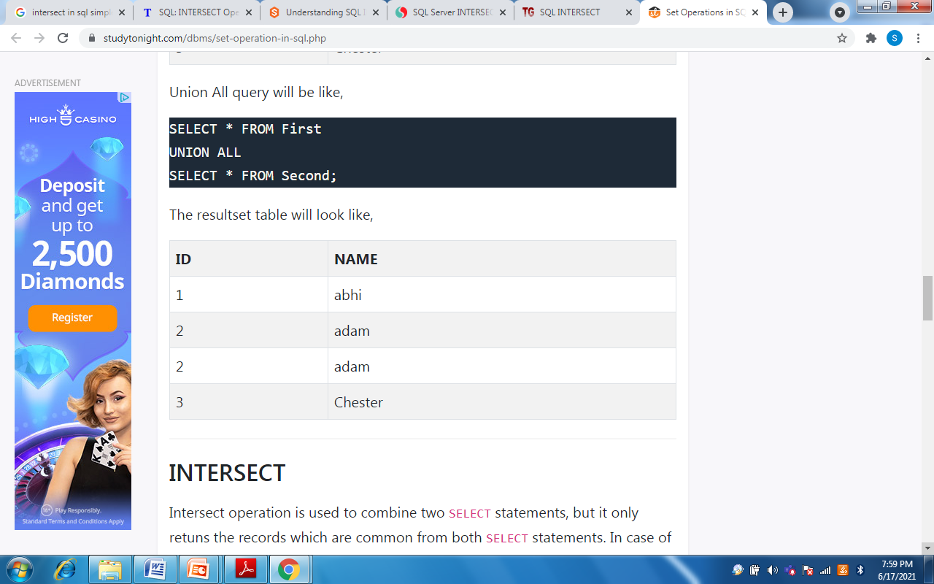
Example 2: UNION ALL

Slide 19
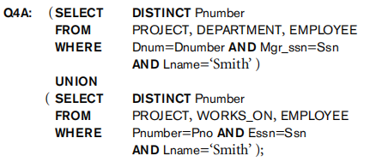
Eg 3) Make a list of all project numbers for projects that involve an employee whose last name is ‘Smith’, either as a worker or as a manager of the department that controls the project.
The first SELECT query retrieves the projects that involve a ‘Smith’ as manager of the department that controls the project, and the second retrieves the projects that involve a ‘Smith’ as a worker on the project. Applying the UNION operation to the two SELECT queries gives the desired result.

Slide 20
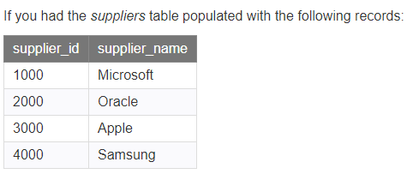
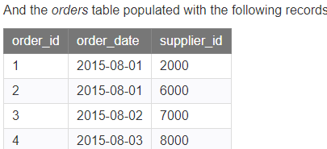
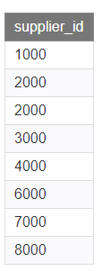
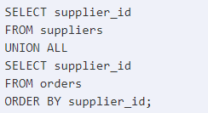

Slide 21
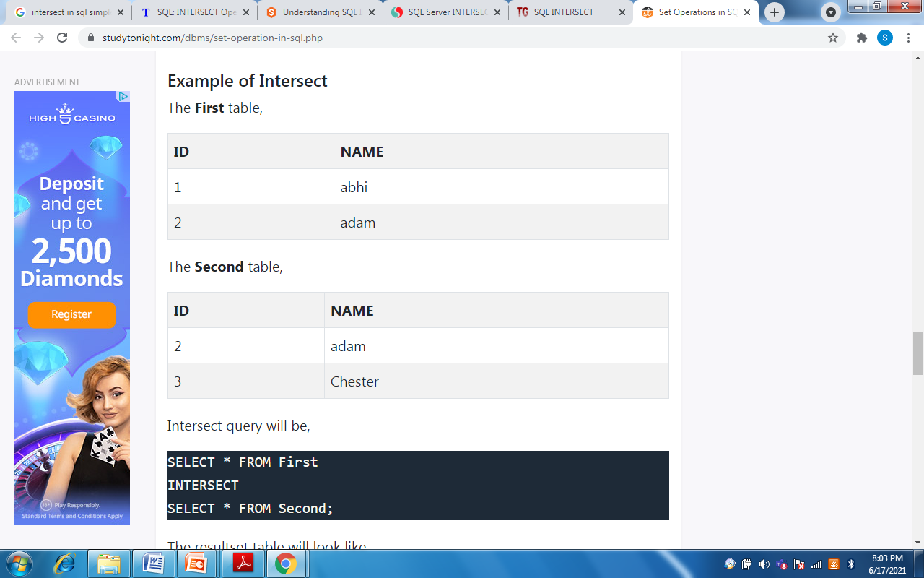
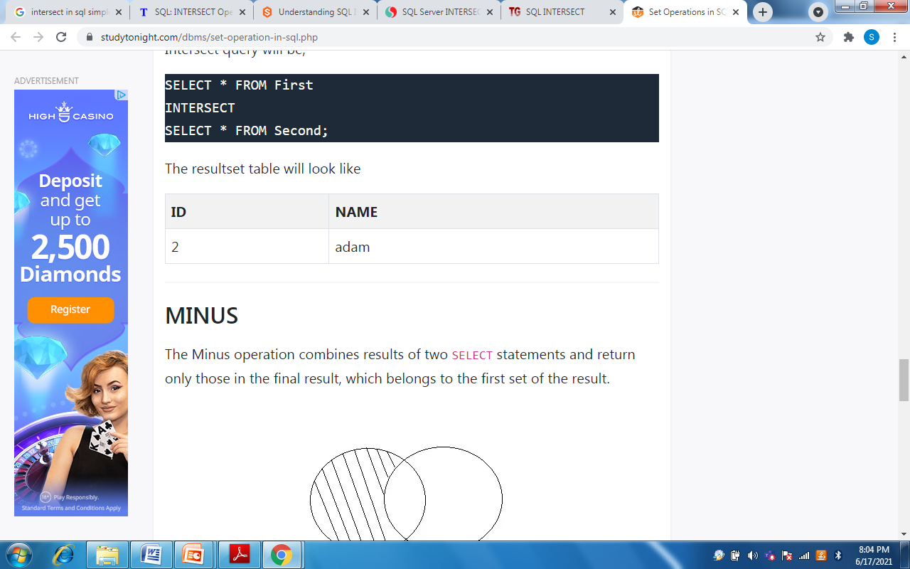
INTERSECT Operator
INTERSECT operator is used to return the records that are in common between two SELECT statements or data sets.
It is the intersection of the two SELECT statements.
Example 1: INTERSECT

Slide 22
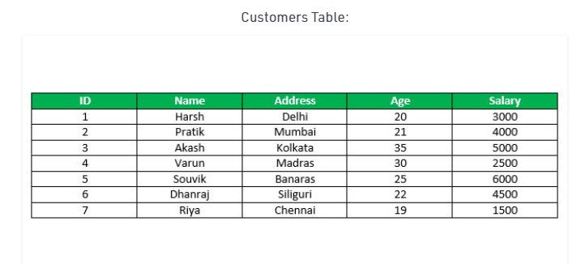
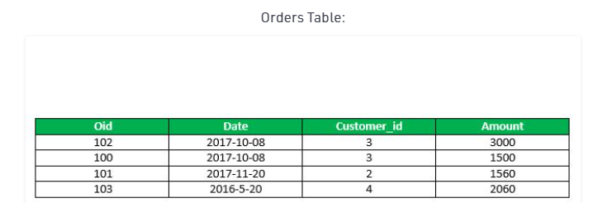
EXAMPLE 2 : INTERSECT

Slide 23
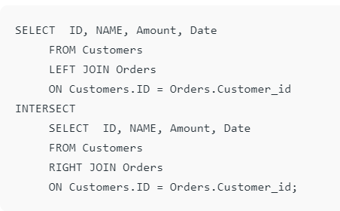
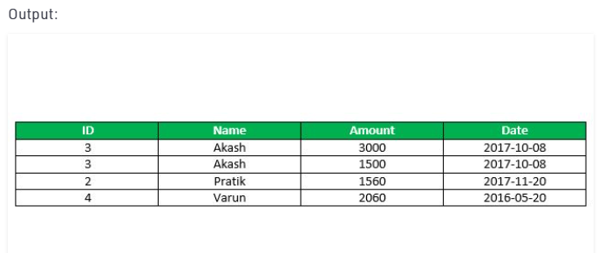

Slide 24
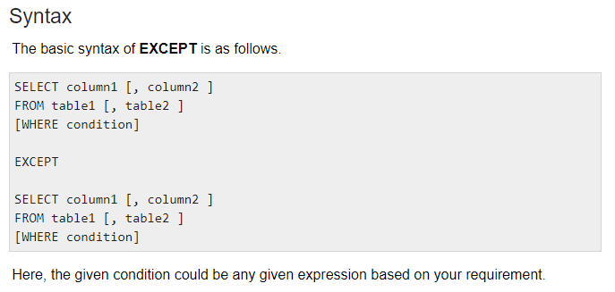
EXCEPT
The SQL EXCEPT clause/operator is used to combine two SELECT statements and returns rows from the first SELECT statement that are not returned by the second SELECT statement.
This means EXCEPT returns only rows, which are not available in the second SELECT statement.

Slide 25
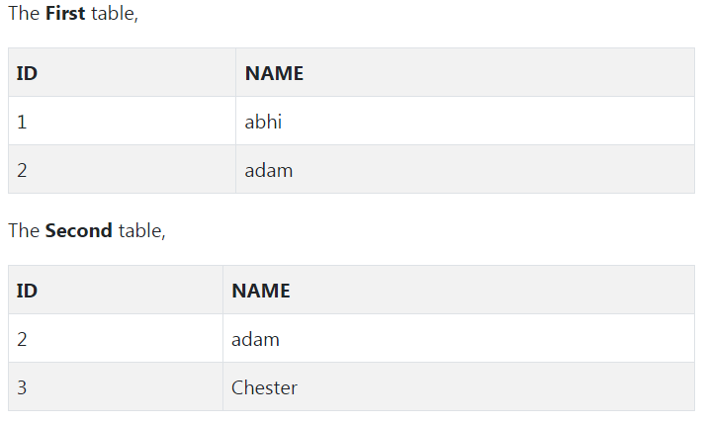
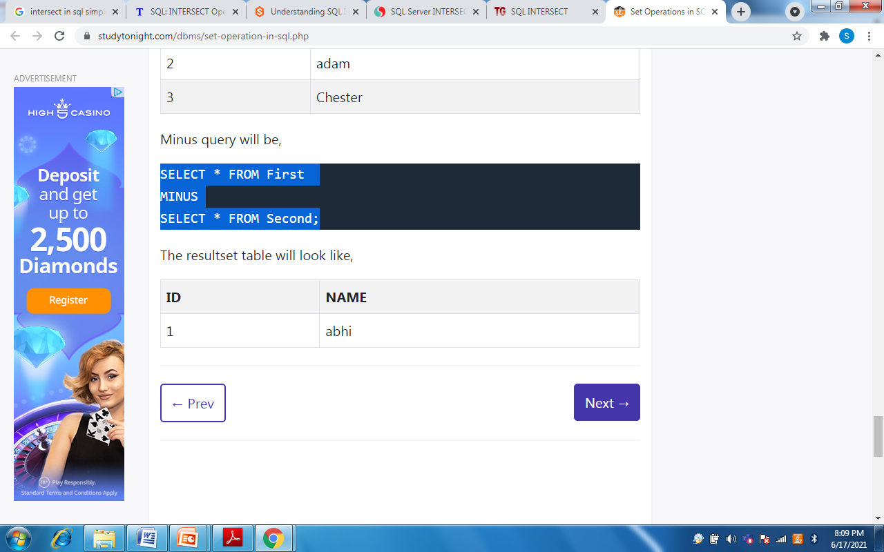
Example 1: EXCEPT
SELECT * FROM First
EXCEPT SELECT * FROM Second;

Slide 26
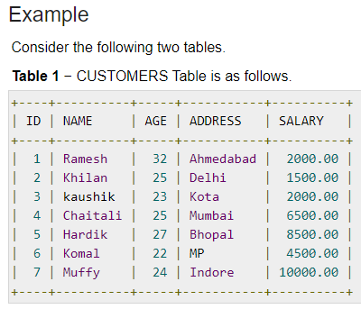
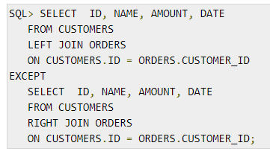
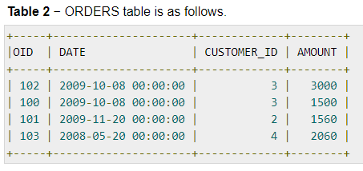
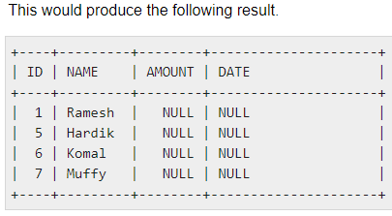

Slide 27

Substring Pattern Matching and Arithmetic Operators
LIKE comparison operator can be used to compare parts of a character string.
This can be used for string pattern matching.
Partial strings are specified using two reserved characters:
% replaces an arbitrary number of zero or more characters, and
the underscore (_) replaces a single character.
Q) Retrieve all employees name whose address is in Houston, Texas.

Slide 28

Q) Find all employees name who were born during the 1950s.
To retrieve all employees who were born during the 1950s,
Here, ‘5’ must be the third character of the string (according to our format for date),
so we use the value ‘_ _ 5 _ _ _ _ _ _ _’, with each underscore serving as a placeholder for an arbitrary character.

Slide 29

BETWEEN
Q)Retrieve all employees in department 5 whose salary is between $30,000 and $40,000.
instead of
Ordering of Query Results
The tuples in the result of a query can be ordered by the values of one or more of the attributes that appear in the query result, using the ORDER BY clause.
The ORDER BY statement in sql is used to sort the fetched data in either ascending or descending according to one or more columns.
By default ORDER BY sorts the data in ascending order.
We can use the keyword DESC to sort the data in descending order and the keyword ASC to sort in ascending order.
The condition (Salary BETWEEN 30000 AND 40000) in Q14
is equivalent to the condition
((Salary >= 30000) AND (Salary <= 40000))

Slide 30
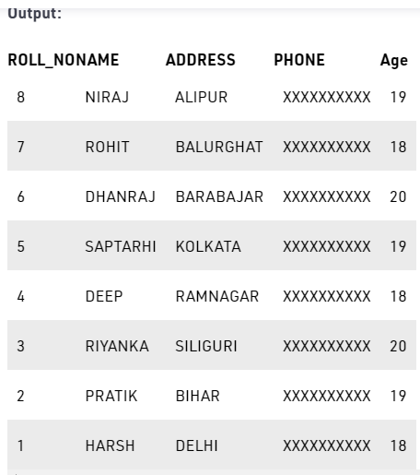
Q) Fetch all data from the table Student and sort the result in descending order according to the column ROLL_NO.
Student Table

Slide 31
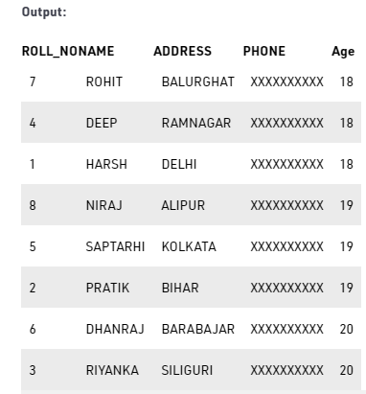
Q) Fetch all data from the table Student and then sort the result in ascending order first according to the column Age. and then in descending order according to the column ROLL_NO.

Slide 32
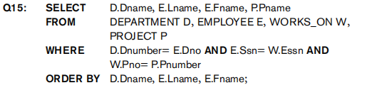
Q) Retrieve a list of employees and the projects they are working on, ordered by department and, within each department, ordered alphabetically by last name, then first name.

Slide 33
NESTED QUERIES
Correlated Nested Queries
Some queries require that existing values in the database be fetched and then used in a comparison condition.
Such queries can be formulated by using nested queries, which are complete SELECT . . . FROM . . . WHERE . . . blocks within the WHERE-clause of another query.
That other query is called the outer query.
In nested queries, the comparison operator IN compares a value v with a set (or multi-set) of values V, and evaluates to TRUE if v is one of the elements in V.
In addition to ‘IN’ operator, all other comparison operators such as (>,>=,<,<= and < >) can be combined with the keywords ANY or ALL.

Slide 34
Whenever a condition in the WHERE-clause of a nested query references some attribute of a relation declared in the outer query, the two queries are said to be correlated.
Q) Retrieve the name of each employee who has a dependent with the same first name and same sex as the employee.
SELECT E.Fname, E.Lname
FROM EMPLOYEE AS E
WHERE E.Ssn IN ( SELECT Essn FROM DEPENDENT AS D WHERE E.Fname= D.Dependent_name AND E.Sex = D.Sex );

Slide 35
Here the nested query has a different result for each tuple in the outer query.
A query written with nested SELECT... FROM... WHERE...
blocks and using the = or IN comparison operators can always be expressed as a single block query.
SELECT E.Fname, E.Lname FROM EMPLOYEE AS E, DEPENDENT AS D WHERE E.Ssn = D.Essn AND E.Sex = D.Sex AND E.Fname=D.Dependent_name;

Slide 36
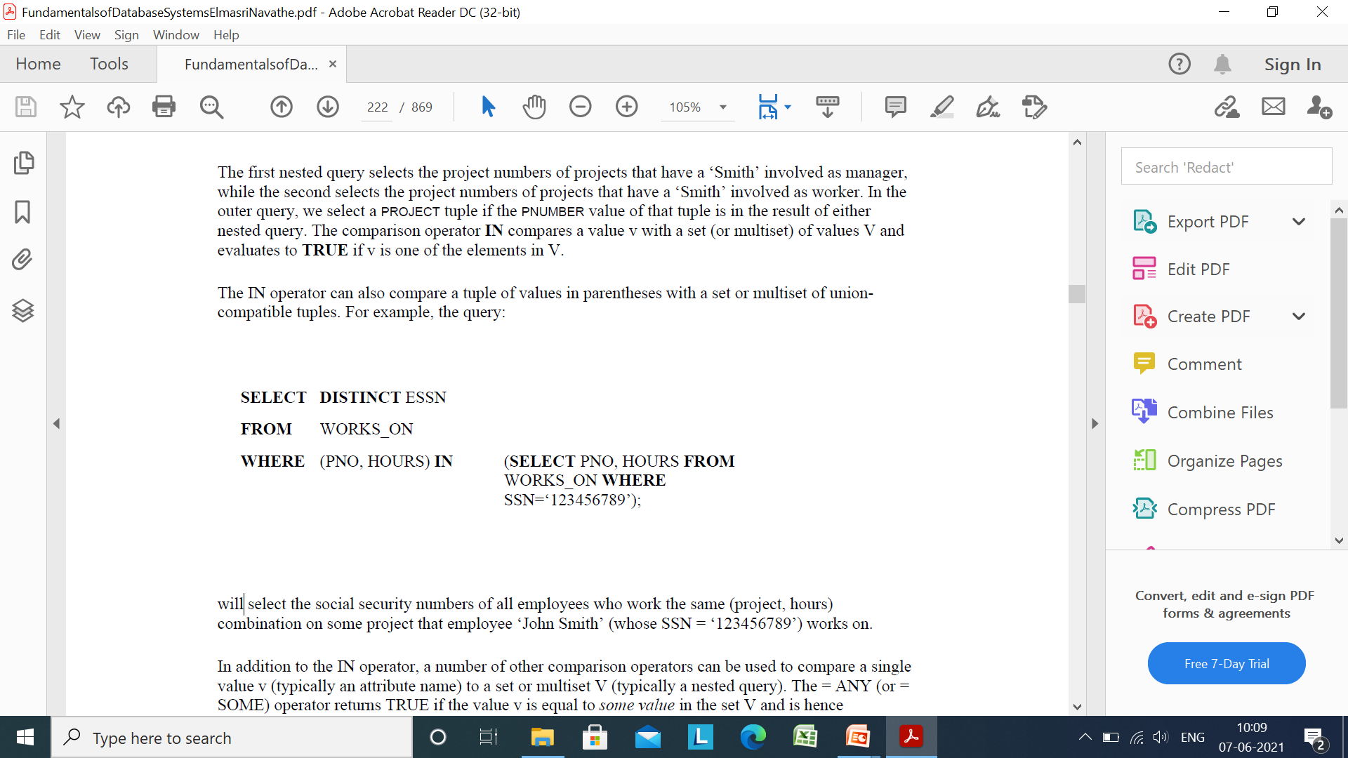
The IN operator can also compare a tuple of values in parentheses with a set or multiset of union-compatible tuples.
Example:
Here it will select the social security numbers of all employees who work the same (project, hours) combination on some project that employee ‘John Smith’ (whose SSN = ‘123456789’) works on.
In addition to the IN operator, a number of other comparison operators can be used to compare a single value v (typically an attribute name) to a set or multiset V (typically a nested query).

Slide 37
The = ANY (or = SOME) operator returns TRUE if the value v is equal to some value in the set V and is hence equivalent to IN.
The keywords ANY and SOME have the same meaning.
Other operators that can be combined with ANY (or SOME) include >, >=, <, <=, and <>.
The keyword ALL can also be combined with each of these operators.
For example, the comparison condition (v > ALL V) returns TRUE if the value v is greater than all the values in the set V.
Q) Retrieve the names of employees whose salary is greater than the salary of all the employees in department 5:
SELECT LNAME, FNAME
FROM EMPLOYEE
WHERE SALARY > ALL (SELECT SALARY FROM EMPLOYEE WHERE DNO=5);

Slide 38
Non-Correlated Nested Queries
Q) Retrieve the name and address of all employees who work for the ‘Research’ Department
The nested query selects the number of the 'Research' department
The outer query select an EMPLOYEE tuple if its DNO value is in the result of either nested query.
In general, we can have several levels of nested queries
A reference to an unqualified attribute refers to the relation declared in the innermost nested query
In this example, the nested query is not correlated with the outer query
SELECT FNAME,LNAME, ADDRESS
FROM EMPLOYEE
WHERE DNO IN (SELECT DNUMBER
FROM DEPARTMENT
WHERE DNAME=’Research’)

Slide 39
Aggregation and Grouping
Aggregate functions are used to summarize information from multiple tuples into a single tuple summary.
In SQL, built-in functions of aggregation are:
1) AVG 2) MIN 3) MAX 4) COUNT and 5) SUM
AVG : It returns an average value of ‘n’, ignoring null values in column.
Eg) SELECT AVG (mark) FROM student;
2) MIN : SELECT MIN (mark) FROM student;
3) MAX: SELECT MAX (mark) FROM student;
4) COUNT : It returns the number of tuples or values as specified in a query.
Eg) SELECT COUNT (*) FROM student;
5)SUM : SELECT SUM (mark) FROM student;

Slide 40
Q) Find the sum of the salaries of all employees, the maximum salary, the minimum salary, and the average salary.
SELECT SUM (SALARY), MAX (SALARY), MIN (SALARY), AVG (SALARY) FROM EMPLOYEE;
Q) Find the sum of the salaries of all employees of the ‘Research’ department, as well as the maximum salary, and the average salary in this department.
SELECT SUM (SALARY), MAX (SALARY), MIN (SALARY), AVG (SALARY) FROM EMPLOYEE, DEPARTMENT WHERE DNO=DNUMBER AND DNAME=‘Research’;
Q) Retrieve i) the total number of employees in the company and ii) the number of employees in the ‘Research’ department.
i)SELECT COUNT (*) FROM EMPLOYEE;
ii) SELECT COUNT (*) FROM EMPLOYEE, DEPARTMENT WHERE DNO=DNUMBER AND DNAME=‘Research’;

Slide 41
Q) Count the number of distinct salary values in the database.
SELECT COUNT (DISTINCT SALARY) FROM EMPLOYEE;
Q) Retrieve the names of all employees who have two or more dependents
SELECT LNAME, FNAME FROM EMPLOYEE WHERE (SELECT COUNT (*) FROM DEPENDENT WHERE SSN=ESSN) >= 2;
Here the correlated nested query counts the number of dependents that each employee has; if this is greater than or equal to 2, the employee tuple is selected.

Slide 42
Grouping : GROUP BY and HAVING Clauses
In order to partition the relation into non overlapping subsets(or groups) of tuples, each group will consist of the tuples that have the same value of attributes called the grouping attributes.
We can apply the function to each such group independently to produce summary information about each group.
SQL has a GROUP BY clause for this purpose.
The GROUP BY clause specifies the grouping attributes which should also appear in the SELECT clause, so that the value resulting from applying each aggregate function to a group of tuples appears along with the value of the grouping attributes.

Slide 43
Q) For each department, retrieve the department number, the number of employees in the department, and their average salary.
SELECT DNO, COUNT (*), AVG (SALARY) FROM EMPLOYEE
GROUP BY DNO;
Q) For each project, retrieve the project number, the project name, and the number of employees who work on that project.
SELECT PNUMBER, PNAME, COUNT (*) FROM PROJECT, WORKS_ON WHERE PNUMBER=PNO GROUP BY PNUMBER, PNAME;

Slide 44
HAVING Clause
It is useful to state a condition that applies to groups rather than to tuples.
It can be used in conjunction with the GROUP BY clause
HAVING provides a condition on the group of tuples associated with each value of the grouping attributes and only the groups that satisfy the condition are retrieved in the result of the query.
Q) For each project on which more than two employees work, retrieve the project number, the project name, and the number of employees who work on the project.
SELECT PNUMBER, PNAME, COUNT (*) FROM PROJECT, WORKS_ON WHERE PNUMBER=PNO GROUP BY PNUMBER, PNAME HAVING COUNT (*) > 2;

Slide 45
Q)For each project, retrieve the project number, the project name, and the number of employees from department 5 who work on the project.
SELECT PNUMBER, PNAME, COUNT (*) FROM PROJECT, WORKS_ON, EMPLOYEE WHERE PNUMBER=PNO AND SSN=ESSN AND DNO=5 GROUP BY PNUMBER, PNAME;
Q)For each department that has more than five employees, retrieve the department number and the number of its employees who are making more than $40,000.
SELECT Dnumber, COUNT (*) FROM DEPARTMENT, EMPLOYEE WHERE Dnumber=Dno AND Salary>40000 AND ( SELECT Dno FROM EMPLOYEE GROUP BY Dno HAVING COUNT (*) > 5)

Slide 46
VIEWS
A view in SQL terminology is a single table that is derived from other tables
These other tables could be base tables or previously defined views. A view does not necessarily exist in physical form; it is considered a virtual table
view is a way of specifying a table that we need to reference frequently, even though it may not exist physically.
Specification of Views in SQL
The command to specify a view is CREATE VIEW.
The view is given a (virtual) table name (or view name), a list of attribute names, and a query to specify the contents of the view.
Eg) VIEW V1

Slide 47
V1 : CREATE VIEW WORKS_ON1
AS SELECT FNAME, LNAME, PNAME, HOURS
FROM EMPLOYEE, PROJECT, WORKS_ON
WHERE SSN=ESSN AND PNO=PNUMBER;
V2: CREATE VIEW DEPT_INFO(DEPT_NAME, NO_OF_EMPS, TOTAL_SAL)
AS SELECT DNAME, COUNT (*), SUM (SALARY)
FROM DEPARTMENT, EMPLOYEE
WHERE DNUMBER=DNO
GROUP BY DNAME;

Slide 48
In View V1, we did not specify any new attribute names for the view WORKS_ON1 (although we could have); in this case, WORKS_ON1 inherits the names of the view attributes from the defining tables EMPLOYEE, PROJECT, and WORKS_ON.
View V2 explicitly specifies new attribute names for the view DEPT_INFO, using a one-to-one correspondence between the attributes specified in the CREATE VIEW clause and those specified in the SELECT-clause of the query that defines the view.
We can specify SQL queries on a view—or virtual table—in the same way we specify queries involving base tables.
For example, to retrieve the last name and first name of all employees who work on ‘ProjectX’, we can utilize the WORKS_ON1 view and specify the query as in QV1:

Slide 49
SELECT Fname, Lname
FROM WORKS_ON1
WHERE Pname=‘ProjectX’;
one of the main advantages of a view is to simplify the specification of certain queries.
Views are also used as a security and authorization mechanism
A view is always up to date; if we modify the tuples in the base tables on which the view is defined, the view must automatically reflect these changes.
If we do not need a view any more, we can use the DROP VIEW command to dispose of it .
Eg) DROP VIEW WORKS_ON1;

Slide 50

View Implementation, View Update and Inline Views
The problem of efficiently implementing a view for querying is complex. For that, two main approaches have been suggested.
1) query modification 2) view materialization
1) query modification involves modifying the view query into a query on the underlying base tables.
The previous query V1 would be automatically modified to the following query by the DBMS.
The disadvantage of this approach is that the views defined via complex queries are time-consuming to execute, especially if multiple queries are going to be applied to the same view within a short period of time.

Slide 51
2) View Materialization involves physically creating a temporary view table when the view is first queried and keeping that table on the assumption that other queries on the view will follow.
Here the view tables are updated automatically in accordance with the updations in base tables. Thus keep the view up-to-date.
An incremental update technique is used for this purpose where the DBMS can determine what new tuples must be inserted, deleted or modified in a materialized view table, when a database update is applied to one of the defining base tables.
The view is kept as a materialized(physically stored)table as long as it is being queried.

Slide 52

View Update
Updating of views is complicated and can be ambiguous.
Consider the WORKS_ON1 view, and suppose that we issue the command to update the PNAME attribute of ‘John Smith’ from ‘ProductX’ to ‘ProductY’.
This view update is shown in UV1

Slide 53
UPDATING VIEWS
There are certain conditions needed to be satisfied to update a view. If any one of these conditions is not met, then we will not be allowed to update the view.
The SELECT statement which is used to create the view should not include GROUP BY clause or ORDER BY clause.
The view must include the PRIMARY KEY of the table based upon which the view has been created.
The SELECT statement should not have the DISTINCT keyword.
The View should have all NOT NULL values.
The view should not be created using nested queries or complex queries.
The view should be created from a single table. If the view is created using multiple tables then we will not be allowed to update the view.

Slide 54
Database system uses one of the three ways to keep the materialized view updated:
Update the materialized view as soon as the relation on which it is defined is updated.
Update the materialized view every time the view is accessed.
Update the materialized view periodically.
in-line view
It is also possible to define a view table in the FROM clause of an SQL query. This is known as an in-line view. In this case, the view is defined within the query itself.

Slide 55
Uses of a View : A good database should contain views due to the given reasons:
Restricting data access – Views provide an additional level of table security by restricting access to a predetermined set of rows and columns of a table.
Hiding data complexity – A view can hide the complexity that exists in a multiple table join.
Simplify commands for the user – Views allows the user to select information from multiple tables without requiring the users to actually know how to perform a join.
Store complex queries – Views can be used to store complex queries.
Rename Columns – Views can also be used to rename the columns without affecting the base tables provided the number of columns in view must match the number of columns specified in select statement. Thus, renaming helps to to hide the names of the columns of the base tables.
Multiple view facility – Different views can be created on the same table for different users.

Slide 56
ASSERTIONS
Assertions can be used to specify additional types of constraints that are outside the scope of the built-in relational model constraints (primary key & unique keys, entity integrity and referential integrity).
Specifying General Constraints as Assertions in SQL
In SQL, we can specify general constraints through declarative assertions, using CREATE ASSERTION statement.
Each assertion is given a constraint name and is specified via a condition similar to the WHERE clause of an SQL query.
The basic technique for writing assertions is to specify a query that selects any tuples that violate the desired condition.

Slide 57
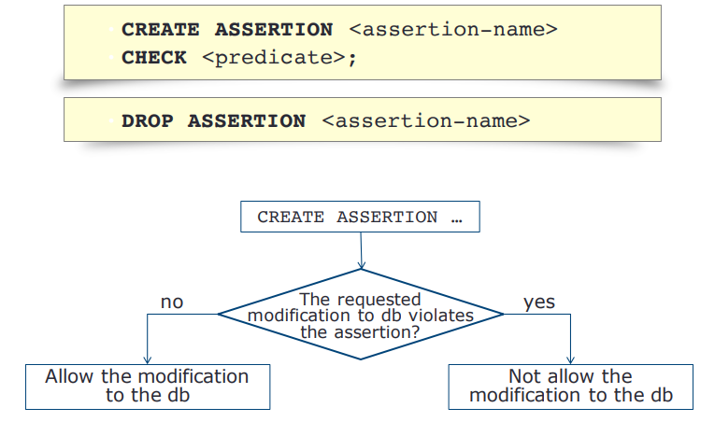
General form of Assertion

Slide 58


Q)The total length of all movies by a given studio shall not exceed 10,000 minutes.
Since this constraint involves only the relation Movies, it can be expressed as a tuple-based CHECK constraint.

Slide 59
Eg) The salaries of an employee must not be greater than the salary of the manager of the corresponding department
CREATE ASSERTION Salary_check CHECK( NOT EXISTS (SELECT * FROM Employee e, Employee m, Department d WHERE e.salary>m.salary AND e.Dno= d.Dunmber AND d.mgr_ssn=m.ssn));
Note: The EXISTS operator is used to test for the existence of any record in a subquery. The NOT EXISTS in SQL Server will check the Subquery for rows existence, and if there are no rows then it will return TRUE, otherwise FALSE.

Slide 60
TRIGGERS
A trigger is a statement that the system executes automatically as a side effect of a modification to the database.
A trigger is a stored procedure in database which automatically invokes whenever a special event in the database occurs.
Action to be taken when certain events occur and when certain conditions are satisfied.
For example,
a trigger can be invoked when a row is inserted into a specified table or when certain table columns are being updated.
it may be useful to specify a condition that, if violated, causes some user to be informed of the violation

Slide 61
Benefits of Triggers
Generating some derived column values automatically
Enforcing referential integrity
Event logging and storing information on table access
Auditing
Synchronous replication of tables
Imposing security authorizations
Preventing invalid transactions

Slide 62
Types of Triggers
Row Trigger : Trigger is fired each time a row in the table is affected
Statement Trigger : Trigger is fired even if no rows are affected
Before/After Trigger : These triggers apply to both row and statement trigger which is to be specify trigger timing.

Slide 63
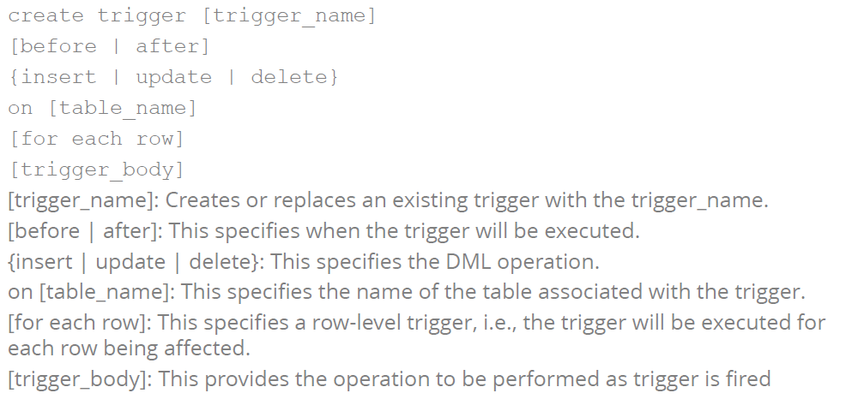
Syntax: Trigger

Slide 64
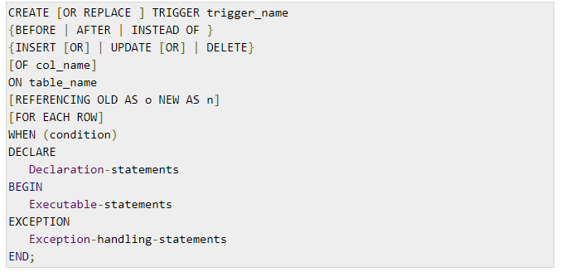
Creating Triggers (complete syntax)

Slide 65
CREATE [OR REPLACE] TRIGGER trigger_name
Creates or replaces an existing trigger with the trigger_name.
{BEFORE | AFTER }
This specifies when the trigger will be executed. (before or after the triggering statement)
{INSERT [OR] | UPDATE [OR] | DELETE}
This specifies the DML operation.
[OF col_name]
This specifies the column name that will be updated.
[ON table_name]
This specifies the name of the table associated with the trigger.

Slide 66
[REFERENCING OLD AS o NEW AS n]
This allows you to refer new and old values for various DML statements, such as INSERT, UPDATE, and DELETE.
[FOR EACH ROW]
This specifies a row-level trigger, i.e., the trigger will be executed for each row being affected.
Otherwise the trigger will execute just once when the SQL statement is executed, which is called a table level trigger.
WHEN (condition)
This provides a condition for rows for which the trigger would fire.
This clause is valid only for row-level triggers.

Slide 67
Example: Given Student Report Database, in which student marks assessment is recorded. In such schema, create a trigger so that the total and average of specified marks is automatically inserted whenever a record is insert.
Note: Here, as trigger will invoke before record is inserted so, BEFORE tag can be used.
create trigger stud_marks before INSERT on Student for each row set Student.total = Student.subj1 + Student.subj2 + Student.subj3, Student.per = Student.total * 60 / 100;
Above SQL statement will create a trigger in the student database in which whenever subjects marks are entered, before inserting this data into the database, trigger will compute those two values and insert with the entered values.

Slide 68
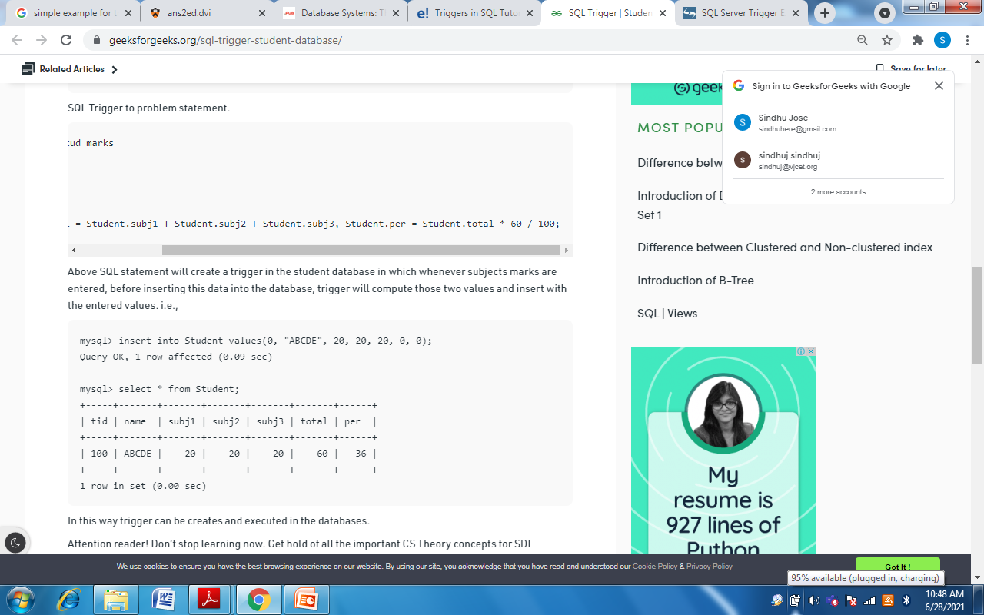
mysql> insert into Student values(100, "ABCDE", 20, 20, 20, 0, 0);
Student

Slide 69
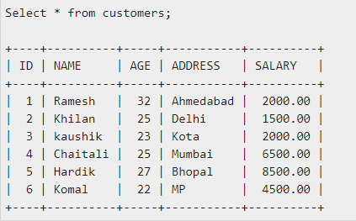
Example
Create a row-level trigger for the customers table that would fire for INSERT or UPDATE or DELETE operations performed on the CUSTOMERS table.
This trigger will display the salary difference between the old values and new values.

Slide 70
